Slide 1
Digital Marketing Campaign Conversion Prediction

Slide 2

1. Introduction
2. Data Collection & Cleaning
3. Exploratory Data Analysis
4. Data Pre-Processing
6. Model Selection
7. Model Evaluation
8. Conclusion

Slide 3
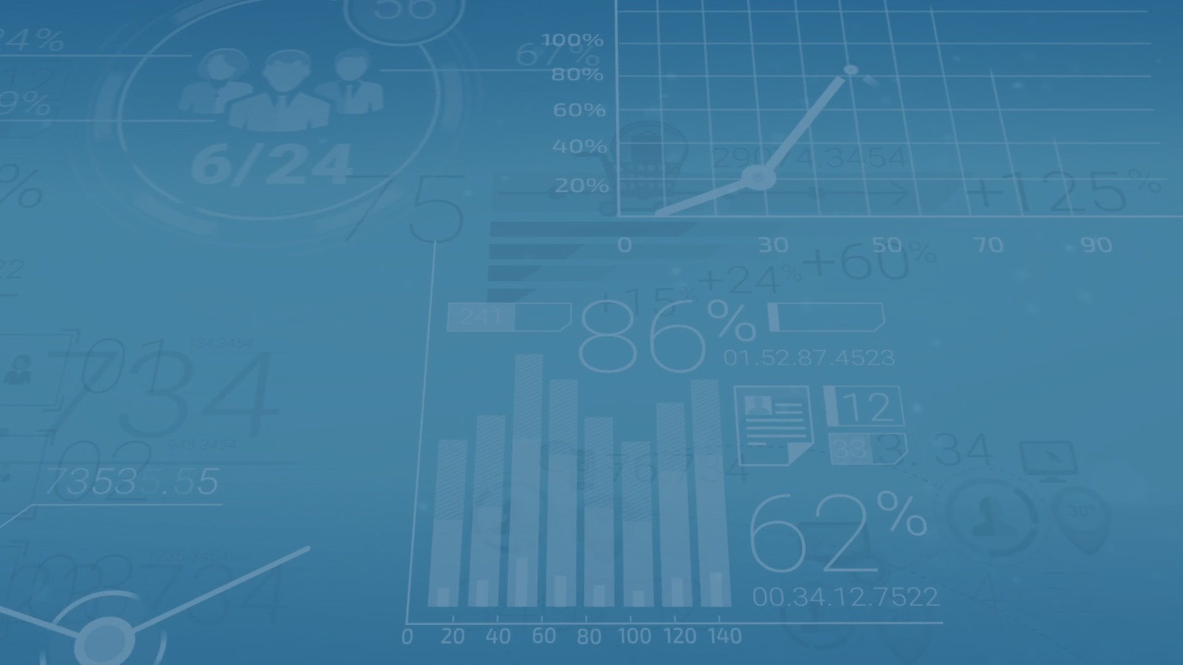
Introduction
Digital marketing promotes products or services online through channels like social media, email, search engines, and websites. It allows businesses to target specific demographics and behaviors, reaching a global audience more precisely than traditional marketing.
Understanding Campaigns:
A digital marketing campaign is a coordinated effort to achieve specific goals, such as increasing brand awareness or driving sales. It can include strategies like social media ads, email marketing, content marketing, and PPC advertising.

Slide 4
Key Metrics:
Conversion Rate: The percentage of users who take a desired action (e.g., purchase).
Click-Through Rate (CTR): The ratio of clicks to ad views.
Return on Advertising Spend (ROAS): Revenue generated per dollar spent on ads.
Conversion Prediction:
Conversion prediction uses data analytics and machine learning to estimate the likelihood of a user completing a desired action, based on historical data and user behavior patterns.
Importance of the Project:
This project aims to build a model that predicts customer conversions, helping marketers target campaigns more effectively, increase conversion rates, and maximize ROAS.

Slide 5

Data Collection & Cleaning
Independent variables:
CustomerID | Age | Gender | Income | CampaignChannel | CampaignType | AdSpend | ClickThroughRate | ConversionRate | WebsiteVisits | PagesPerVisit | TimeOnSite | SocialShares | EmailOpens | EmailClicks | PreviousPurchases | LoyaltyPoints | AdvertisingPlatform | AdvertisingTool
0 | 8000 | 56 | Female | 136912 | Social Media | Awareness | 6497.870068 | 0.043919 | 0.088031 | 0 | 2.399017 | 7.396803 | 19 | 6 | 9 | 4 | 688 | IsConfid
Dependent variable:
Dropping:
Conversion
0/1
CustomerID : all unique vales
AdvertisingTool : no unique values
Null /Duplicate values:
AdvertisingPlatform : no unique values
Age 0 Gender 0 Income 0 CampaignChannel 0 CampaignType 0 AdSpend 0 ClickThroughRate 0 ConversionRate 0 WebsiteVisits 0 PagesPerVisit 0 TimeOnSite 0 SocialShares 0 EmailOpens 0 EmailClicks 0 PreviousPurchases 0 LoyaltyPoints 0 Conversion 0 dtype: int64

Slide 6
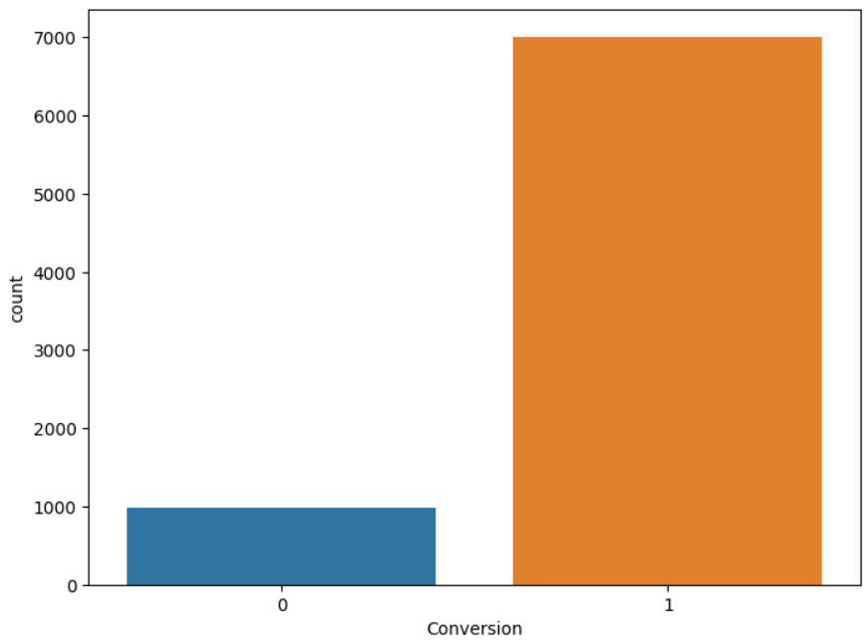
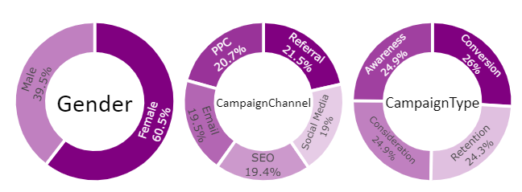
Exploratory Data Analysis
Target variable
Distribustion of Categorical Varibles
Insights:
- Imbalanced data set
- Fair distribution of categorical varibles - Non- linear dense data
- No outliers present

Slide 7
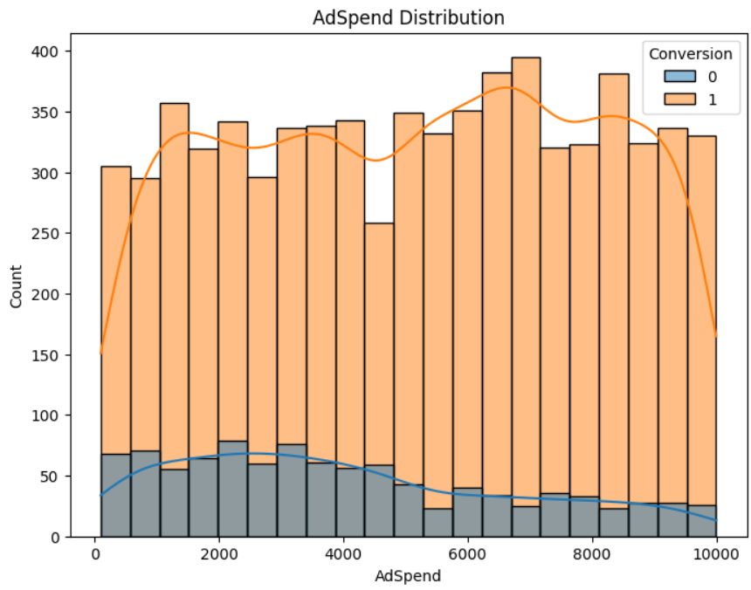
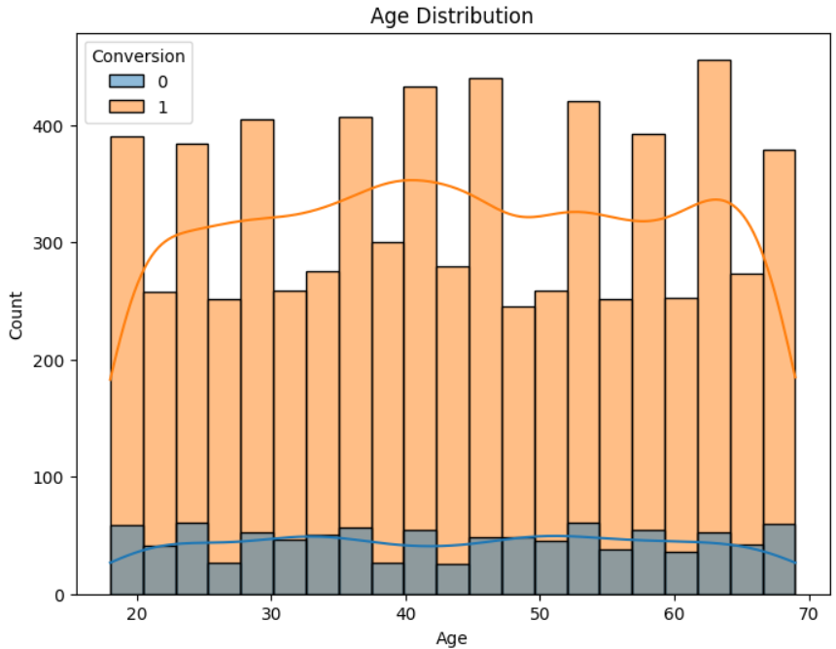
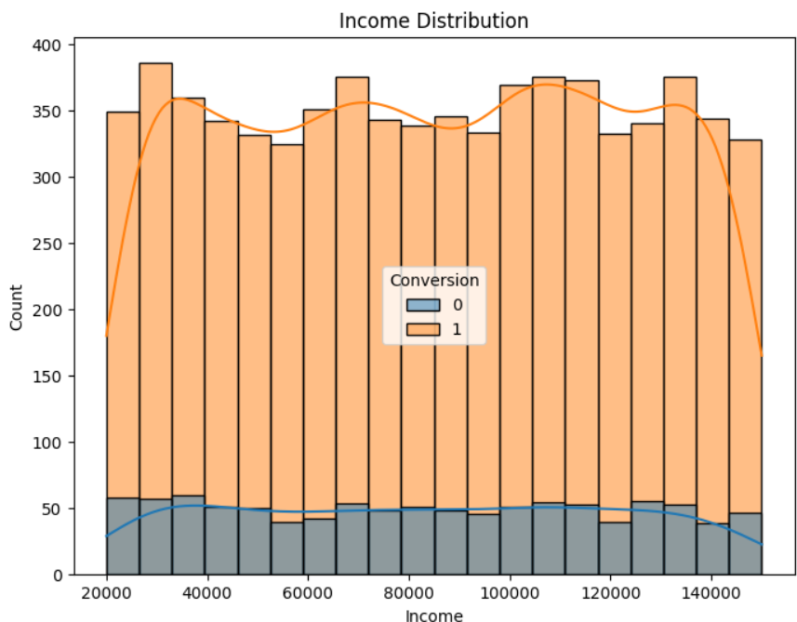
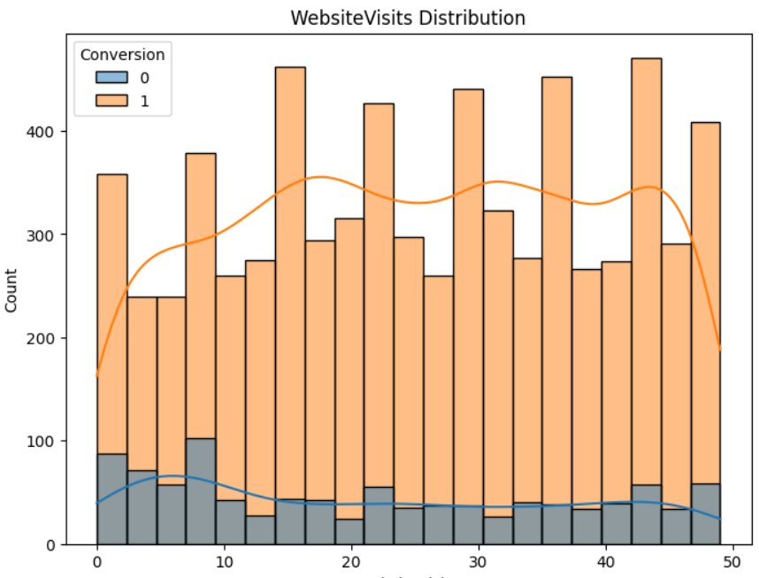
Distribution of Continous Variables
Age
Adspend
Income
Website Visits

Slide 8
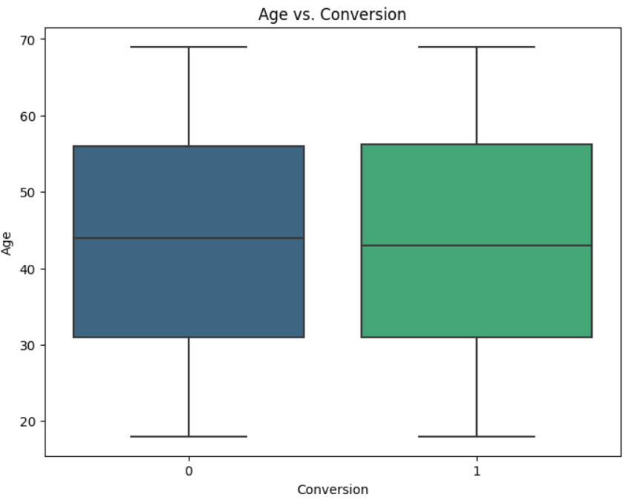
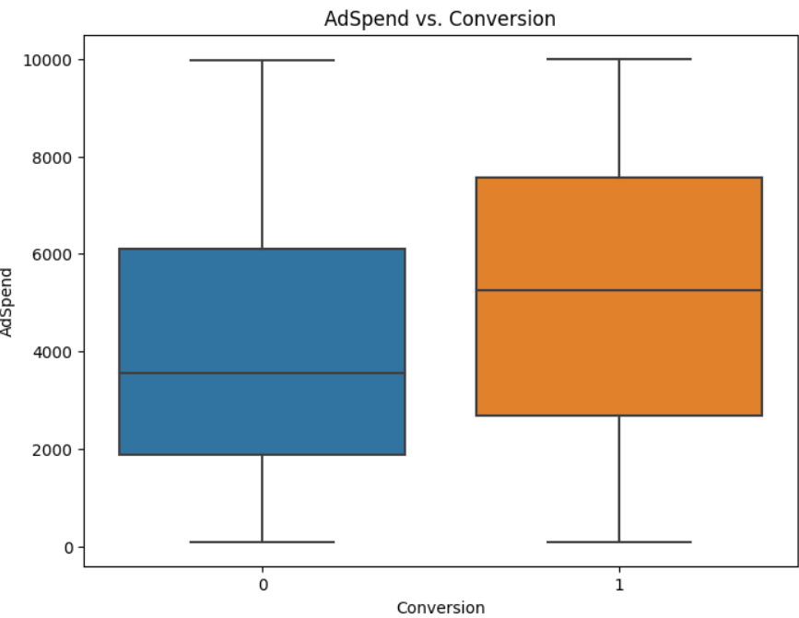
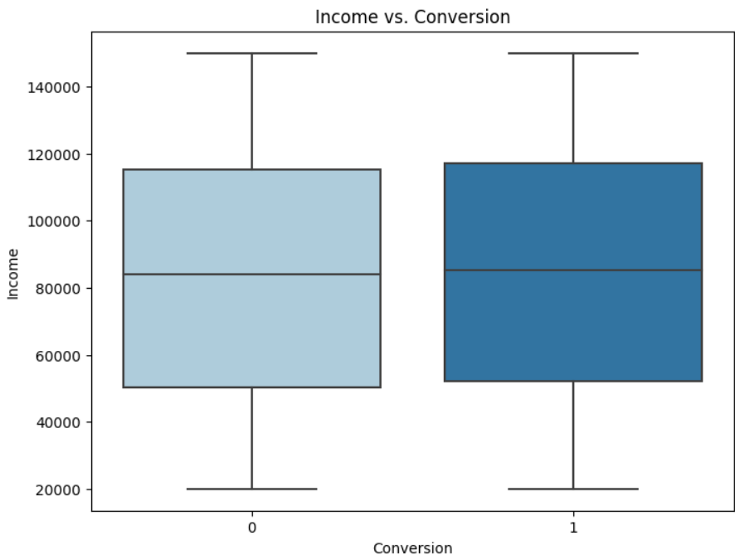
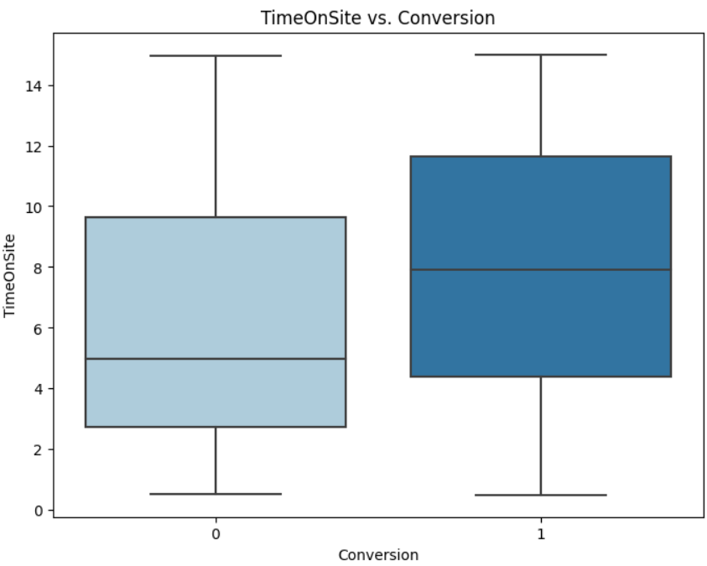
Checking for Outliers
Age
Adspend
Income
Time on Site

Slide 9
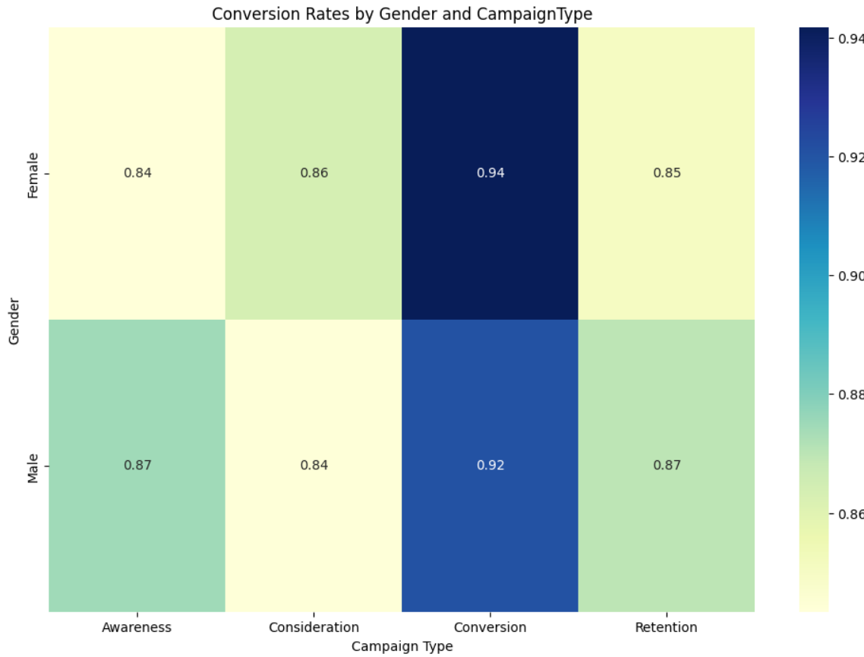
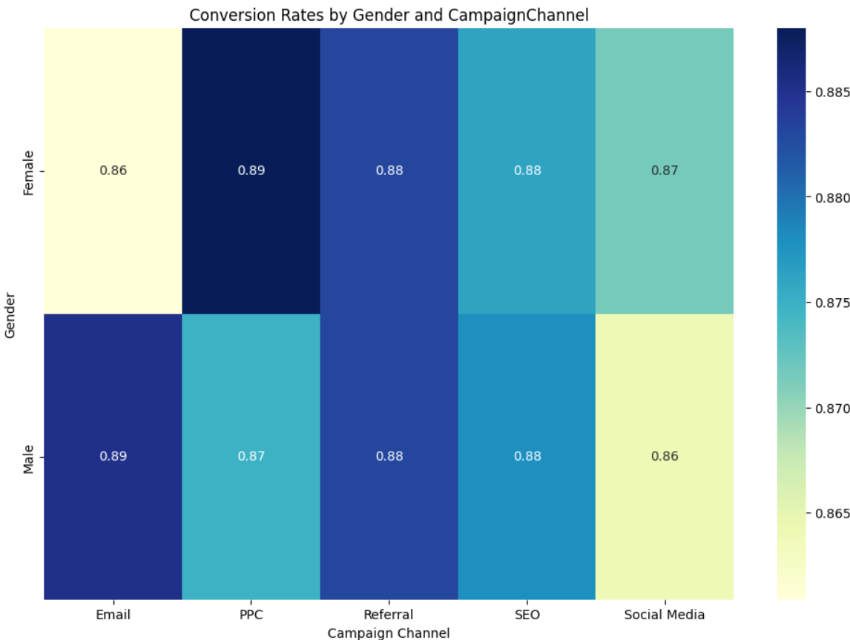
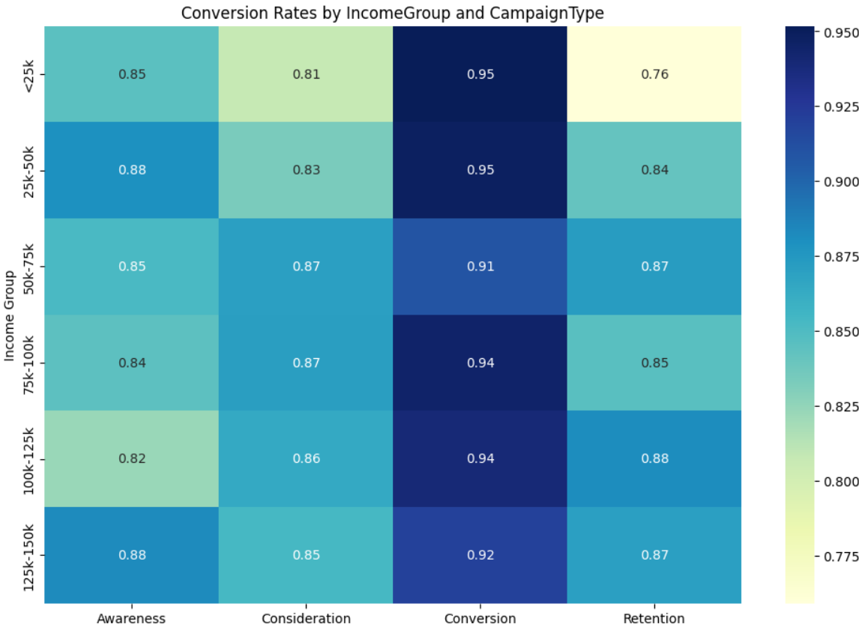
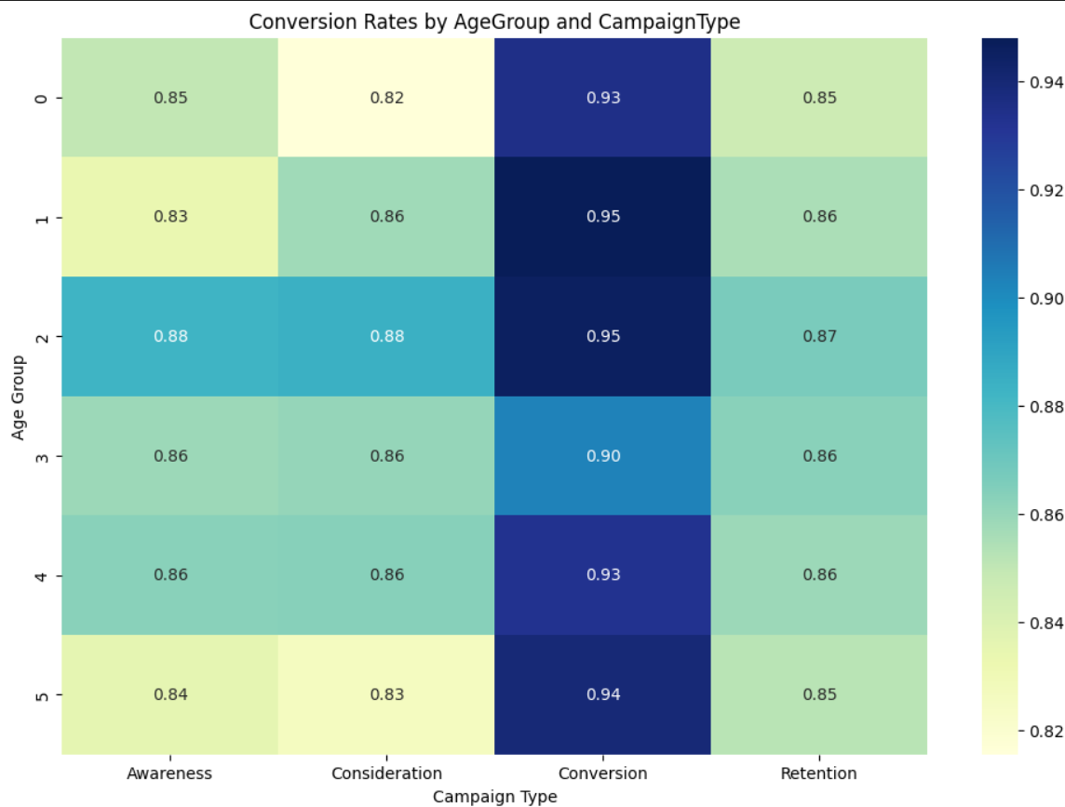
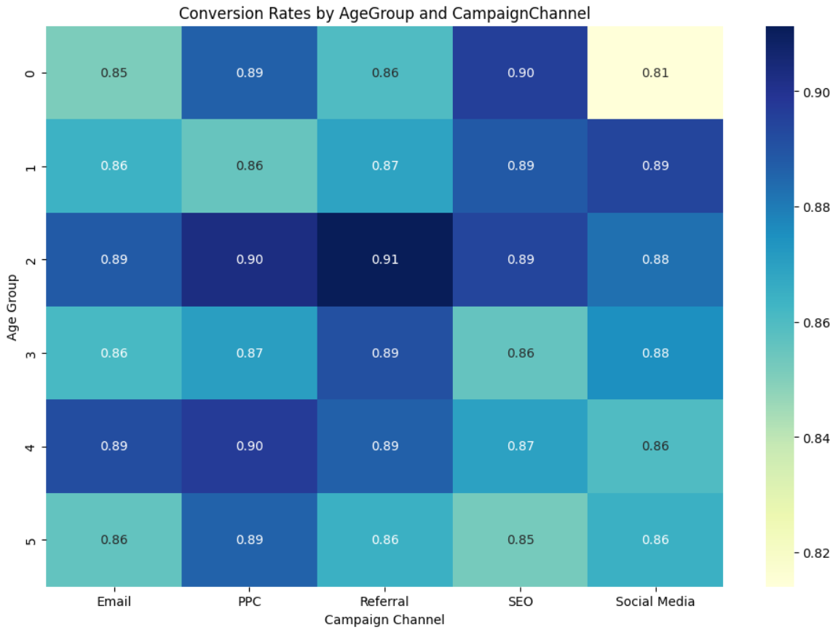
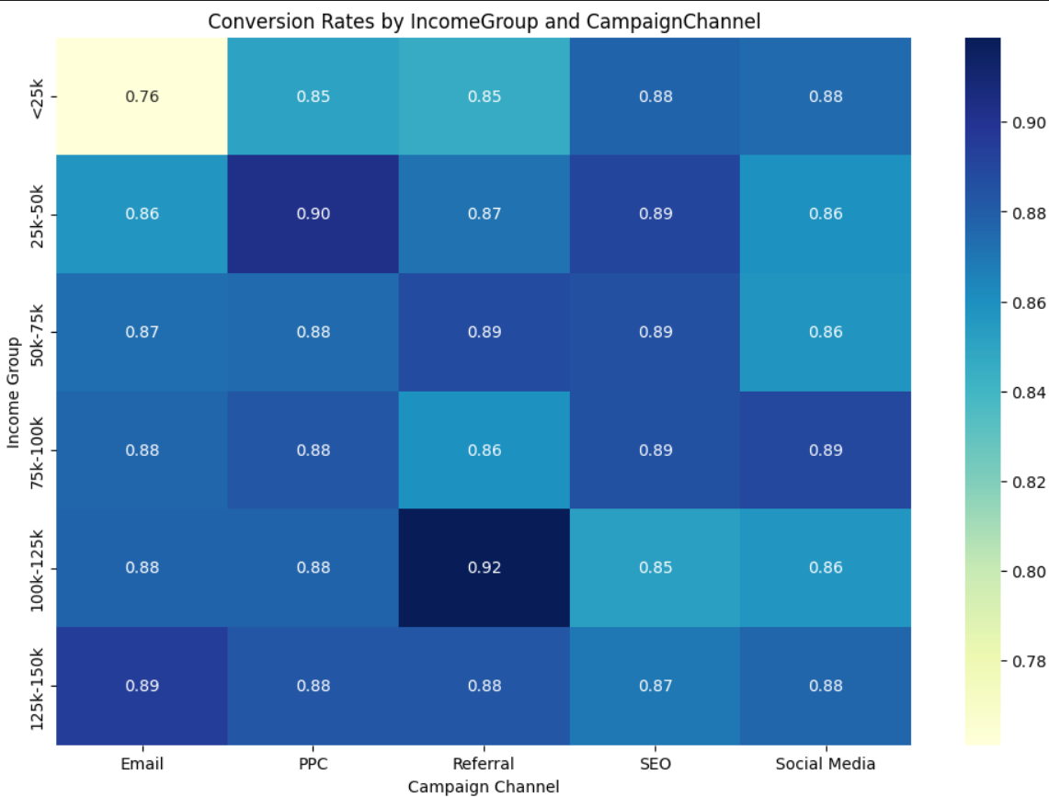
Heat maps-Descretization

Slide 10

Insights
Male Group:
Highest Conversion Rates: 1.Typically appear in higher income segments 2.Perform best in the Referral and Email channels.
Lowest Conversion Rates: 1.Usually found in lower income segments. 2.Perform poorly in the PPC and SEO channels.
Female Group:
Highest Conversion Rates: 1.Typically appear in higher income segments. 2.Perform best in the Retention activity type and the SEO and Email channels.
Lowest Conversion Rates: 1.Usually found in lower income segments. 2.Perform poorly in the Consideration activity type and the SEO and PPC channels.

Slide 11
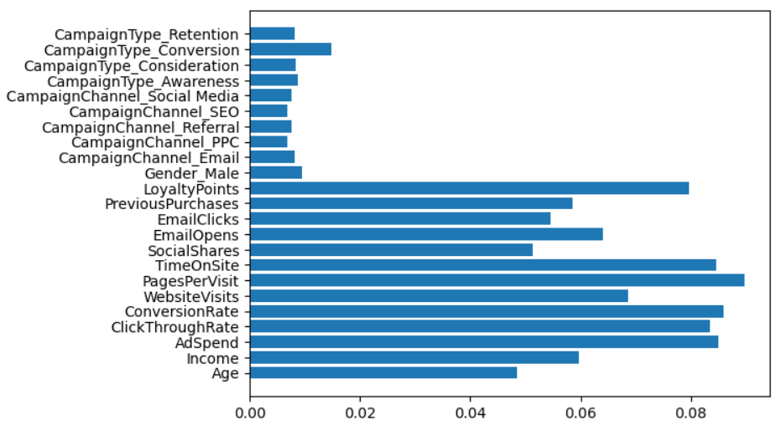
Data Pre-Processing
SMOTE : Due to the imbalanced natue of the dataset , SMOTE performed on the dataset. Before SMOTE: Counter({1: 5606, 0: 794}) After SMOTE: Counter({1: 5606, 0: 5606})
One hot encoding : All categorical variables -Gender, Campaign Type, Campaign Channel undergone one hot encoding as there is no paticular order to them.
Removal of Features : Based on the above importance score graph(based on Random Forest), Campaign type, Campaign Channel and Gender removed(tested with and without the features)
PCA : Due to the dense nature of the data , for reduction of the dimentionality, Principle Component Analysis has been performed.
Scaling : Bringing all the data to the same scaled standardized range for better insights.
Splitting : 1. X:Independent variables 2. y:Dependent variables 3. X_train_red,y_train_red:training data set after reduction of features. 4. X_test_red,y_test_red:testing data set after reduction of features.

Slide 12
Model Selection & Evaluation
Logistic Regression(LR): Showed lowest accuracy due to the non-linear nature of the dataset
Decison Tree Classifier(DT) : Handled the high dimentionality of the data better than Logistic Regressor.
Random Forest(RF): Showed highest accuarcy amongst LR and DT.
SVM : Used the ‘rbf’ kernel to solve non-linearity
Gradient Boost Classifier : Still lesser accuracy than RF.
XG Boost Classifier: Highest accuracy amongst all models
Metric | Logistic Regression | Decision Tree Classifier | Random Forest Classifier | Support Vector Machine | Gradient Boosting Classifier | XG Boost Classifier
Accuracy | 0.7288 | 0.7600 | 0.8788 | 0.8106 | 0.8731 | 0.904375
F1 Score | 0.7730 | 0.7846 | 0.8753 | 0.8291 | 0.8780 | 0.9468565474122959
Precision | 0.9508 | 0.9011 | 0.9238 | 0.9299 | 0.9400 | 0.9469
Recall | 0.7290 | 0.8165 | 0.9395 | 0.8485 | 0.9139 | 0.9106
ROC AUC Score | 0.7279 | 0.5835 | 0.6888 | 0.6923 | 0.7456 | 0.81002

Slide 13

Conclusion
Key Findings : 1. After further applying hyperparameter tuning techniques like Grid Search CV , XG Boost Classifier has showed the highest accuracy of 91% . 2. Furthermore , to rely on its accuracy , Cross Validation techniques were performed that gave uniform results on each subset.
Limitations: 1. Adaptability to New Data: The model may perform well on historical data but could struggle with new data if there are shifts in customer behavior, market conditions, or campaign strategies. 2. Uncertain ROI: Despite the model’s accuracy, the actual impact on conversion rates, customer acquisition costs, and return on ad spend (ROAS) may vary, and it might take time to realize the full benefits.
Future Research: 1. Integrating additional data sources, such as social media engagement, customer reviews, or sentiment analysis, to enhance the model's predictive power. 2. Investigating the use of deep learning models, such as neural networks, which may capture more complex patterns in the data, could be a worthwhile direction, particularly if you have access to larger datasets

Slide 14
Thank You!

